Slide 1
User Guide
Sofi TMDB API Project
Notes:
Author : Arpan Saini

Slide 2
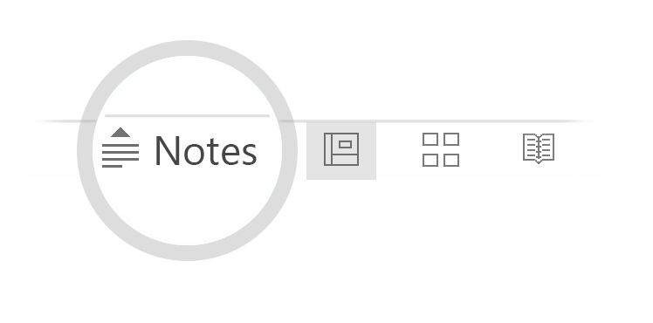

Here's your outline to get started
Key facts about SoFi TMDB API Project
Release date: April 08, 2018
Developer: Arpan Saini
Tool Used: Soap UI NG Pro (Ready API)
Publisher: Arpan Saini
Platform: Microsoft Windows
Sofi TMDB API Project is designed using SOAP UI Pro that has configured with GIT/GIT Hub for version management and enable a team of multiple people, Sitting at different locations to work simultaneously on the project.
Can be run using bat file or from a command line.
Auto generation of Test Execution Reports.
Capable enough for generating configurable dashboards.
Can be run on Multiple Environments. Environment Variables are configurable.
API Key is a configurable. Session ID and Guest session ID are stored on the fly at project level to Reuse it for Another Test cases.
Include extensively Positive and Negative scenarios for different aspects of functional Testing.
Includes Assertions at each level to verify the Expected Http status and Data validation and different aspects of the Functional testing.
See more: Open the Notes below for more information.
Notes:
Area of Improvement can be seen on next slide.

Slide 3
Area of Improvement
Can create Load and Security Test using same function designed test cases. That will save a lot of cost and time in favor of project.
For Data Driven Testing, External source of data can be configured. Like files , Excel and DB. By using data driven testing, Test case can be highly configurable to run on Multiple data that’s not possible using a manual testing. And Expected results can be passed from Data sources to make it highly configurable and reusable Test scripts.
Can be configured to run on synthetic as well as on Migrated data. This is help to find out the challenges and problems that we can be faced during productions and will be ready before hand.
Can be configured with Build tools like Jenkins. That can eliminate the human intervention for the Building the project and resolve the deployment and build issues.
We can use the Data Export Feature of the Tool to configure it with external tool like Jasper soft to make the more beautiful and Configurable Reports for Higher Management Reporting.
See more: Open the Notes below for more information.
Notes:
Scope of Improvement is not just restricted to the above mentioned points. There are more aspects of improvement like Performance, Configurations with External tools, Using Scripting languages to
Make Project More dynamic etc.

Slide 4

INSTALLATION GUIDE
1. Sign up at https://www.themoviedb.org/
2. Request for Api Key.
3. How To Clone Project From GITHub.
4. How To Import Composite Project to Your SOAP UI Pro tool.
5. Configuration Changes.
6. How to Run Project using SOAP UI Pro from different Level like Project , Test Suite and Test Case Level.
7. How to Run Project using Command Line.
8. How To Run Project using bat file.
9. How to Get Test Execution Reports.
10. How to check Dashboard.

Slide 5
Sign up at https://www.themoviedb.org/
Please check with the instructions in the embeded document given below.
File Location in Project
SoFi_TMDB_API_Project/User Manuals/ The movie DB Signup Manual

Slide 6
How To Request for API Key
Please check with the instructions in the embeded document given below.
File Location in Project
SoFi_TMDB_API_Project/User Manuals/ How_To_get_API_Key Manual

Slide 7
How To Clone Project From GitHub
Please check with the instructions in the embeded document given below.
File Location in Project
SoFi_TMDB_API_Project/User Manuals/ How To Clone Project From Github Manual.pdf

Slide 8
Installation Configuration and Run Project Manual
Please check with the instructions in the embeded document given below.
File Location in Project
SoFi_TMDB_API_Project/User Manuals/ Installation_Configuration_and_Run_Project_Manual.pdf

